Slide 1
Clothing Retail Store DBMS,
Group 8
Entity-Relationship (ER) Diagram
Notes:
[ESHANA]
Good morning, we are Group 8, and our project is the Clothing Retail Store Database Management System.
In Assignment 1, we described the application and identified the main functions such as managing products, tracking customer orders, processing payments, and keeping inventory upto date.
For Assignment 2, we have translated that description into a formal Entity-Relationship Model. Our ER diagram contains seven entities, each with primary keys, foreign keys, and relationships defined using crow’s-foot notation.

Slide 2
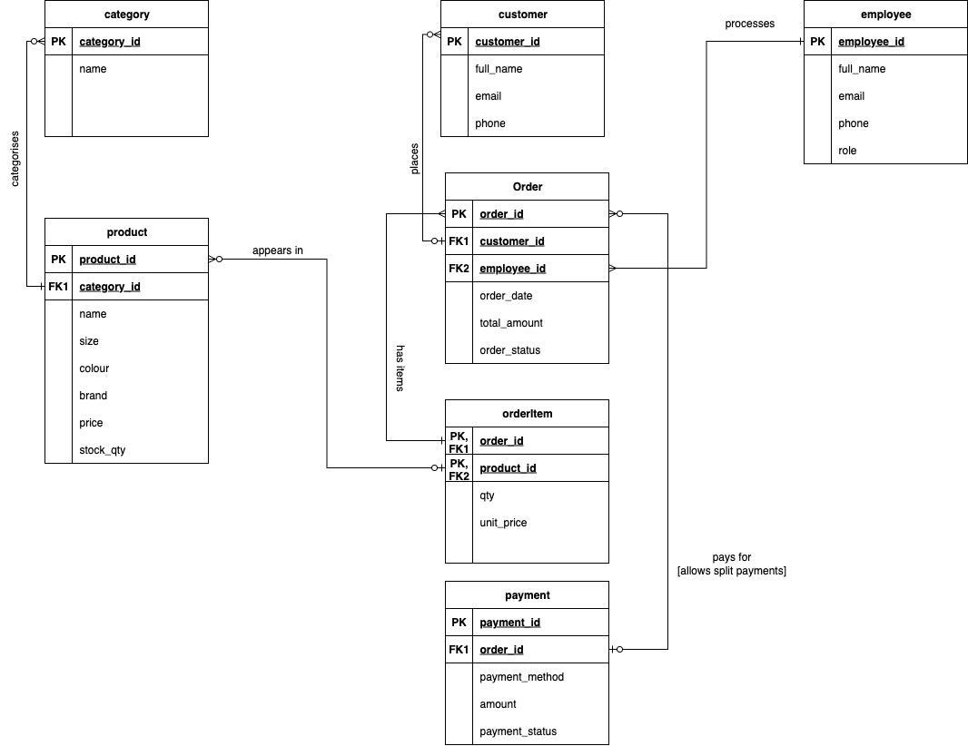
Entity-Relationship (ER) Diagram for Clothing Retail Store DBMS
Notes:
[AMARTYA]
Here’s our ER diagram.
At the centre of the model, we have the order entity, which connects customers, employees, payments, and orderItems.
Orders are placed by customers which are then processed by employees.
Each order consists of one or more orderItems, which act as an associative entry between orders and products.
Each product belongs to a category, which helps us organize the inventory.
Finally, orders are linked to payments, which allow partial or split payment methods.
As shown, all relationships are labeled with crow’s-foot notation, marking the cardinalities explicitly.

Slide 3
Design Choices and Rules
Refinements:
Added ‘employee’ entity since A1 → captures which staff member processes an order
Business Rules:
Each order must contain >= 1 orderItem
Product stock cannot be negative
Payment methods: cash, credit, debit
Orders may allow partial/split payments
Notation:
PKs and FKs are shown inside entities
Crow’s-foot notation used for 1:N cardinality
Notes:
[WALIED]
In refining our model, we’ve added the employee entity compared to Assignment 1. This allows us to capture which staff member processes which orders, making the system more traceable.
We’ve also established some key business rules:
Each order must contain at least one orderItem
Product stock cannot drop below zero
Payment methods are restricted to cash, debit and/or credit
An order may have multiple payments, supporting partial or split transactions
Together, these choices ensure data integrity and align the design with real retail store operations.

